Slide 1

Get the best exchange rate with us for your next travel
Hanyu
23008275

Slide 2
Contents
Customer Pain point
Target Audience
Proposed solution
Relevant MAS regulations
Reference Sources

Slide 3

01
Customer pain point

Slide 4
Customer pain point
-When planning for your upcoming travels, one of the key considerations is determining which bank offers the highest exchange rates to make the most of your money abroad.
-Ensuring the security of your personal information is secure, especially when applying for overseas cards such as Youtrip. It's natural to harbor concerns about safeguarding sensitive details during the application process.
-Another important factor to ponder is whether your bank card is equipped for international use. It's essential to confirm its compatibility with foreign transactions to avoid any unexpected hurdles while traveling.
-Additionally, navigating through the international finance means grappling with the reality of high taxes and transaction fees. Being mindful of these financial implications and exploring ways to minimize them can contribute to a smoother and more cost-effective travel experience.

Slide 5

02
Target Audience

Slide 6
Target Audience
Frequent Travelers
Individuals that travels often for business or for holidays that require fast and
efficient currency exchange
Long term permanent resident
Long term permanent resident that stay in another country. Require an oversea
bank card that can exchange money anytime anywhere without the need to wait
for transaction process period
Student Studying oversea
Students who are studying oversea require an easy to access account that is
Reliable and low transactions fee.

Slide 7

03
Proposed solution

Slide 8
Proposed solution
Embedded Finance
By integrating Embedded Finance into multi-currency transactions, the application allows user to top-up money into the application’s wallet by using direct bank transfer (by linking user’s bank card to the app) or QR code (paynow, paylah!) transfer. After topping up the wallet, users can then convert the money into their chosen currency without a conversion fee. Users can then use the virtual card like a debit card to pay for their purchases.

Slide 9

04
Business idea
This Photo by Unknown Author is licensed under CC BY-SA

Slide 10
Business idea
Create a digital travelling E-wallet which is like an international debit card that allow anyone that use it to change money easily and efficiently with low or no transaction fee. They are allowed to send money locally and internationally through the online services. There will also be a monthly data statistics on where you spend your money monthly.

Slide 11

05
Relevant MAS regulations
This Photo by Unknown Author is licensed under CC BY-NC-ND

Slide 12
Relevant MAS regulations
Payment Service Act (PSA)
Under the PSA regulation, businesses that provides payment services must obtain necessary licenses to operate legally in Singapore.
Personal Data Protection Act (PDPA)
Under the PDPA regulation, businesses are required to implement strict data protection measures to safeguard user’s sensitive information.
Anti-Money Laundering (AML/CFT)
Under the AML regulation, business must implement strong AML measures to prevent money laundering and terrorist financing this

Slide 13
06
Reference Sources

Slide 14
Reference Sources
-https://www.mas.gov.sg/regulation/acts/payment-services-act
-https://www.mas.gov.sg/regulation/anti-money-laundering
-https://www.pdpc.gov.sg/overview-of-pdpa/the-legislation/personal-data-protection-act
-https://www.forbes.com/sites/forbestechcouncil/2023/02/09/the-rise-of-embedded-finance-exploring-the-next-wave-of-digital-banking/?sh=5ddf3c16309d

Slide 15
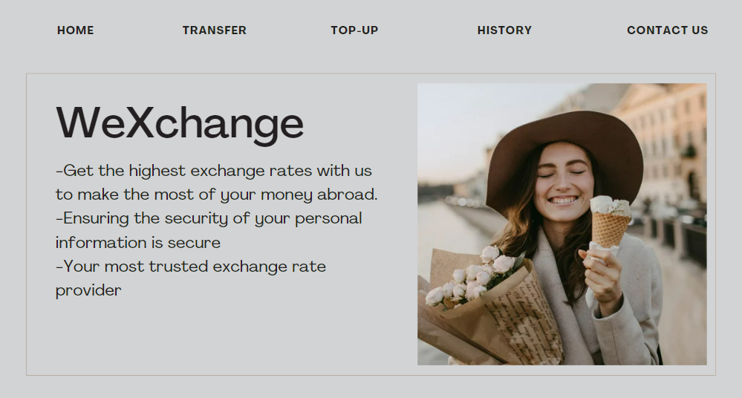

Slide 16
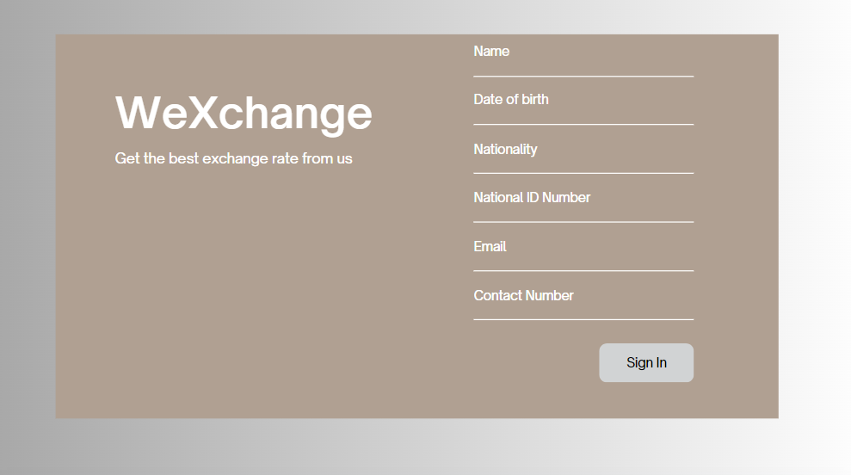

Slide 17
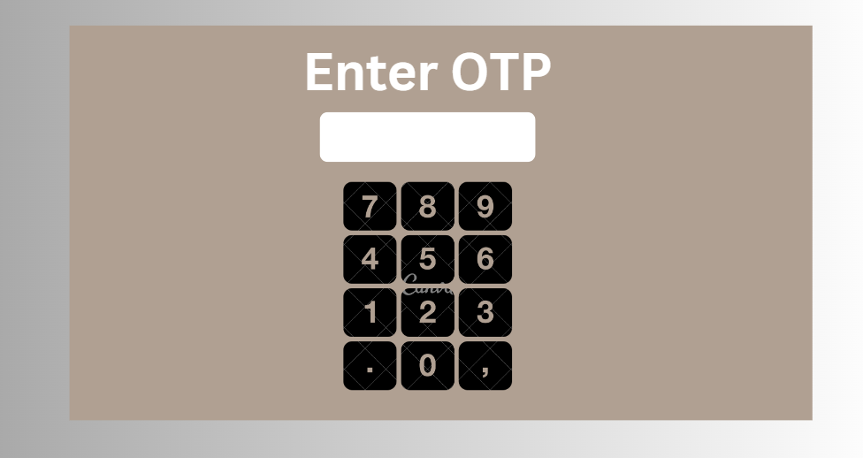

Slide 18
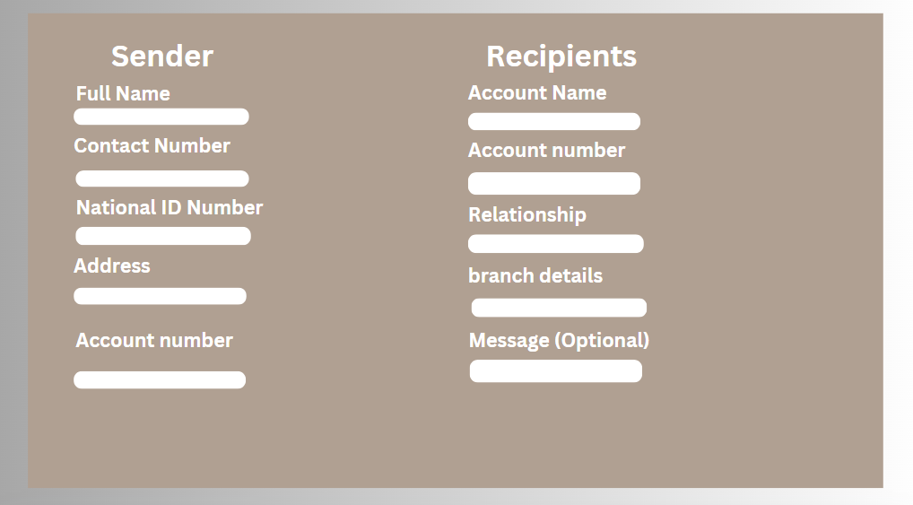

Slide 19
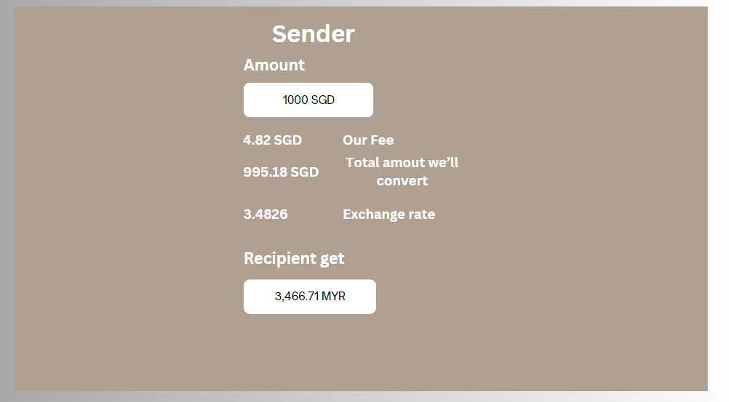

Slide 20
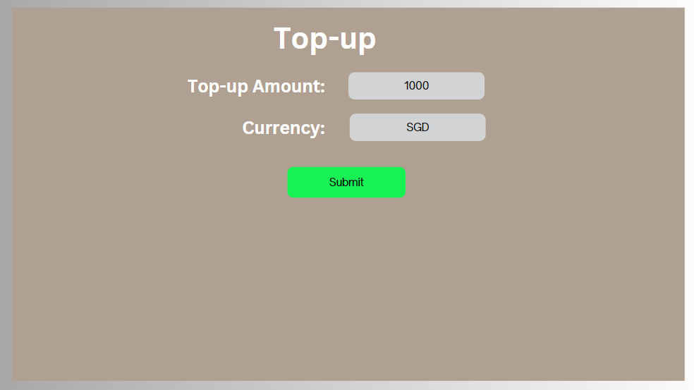

Slide 21
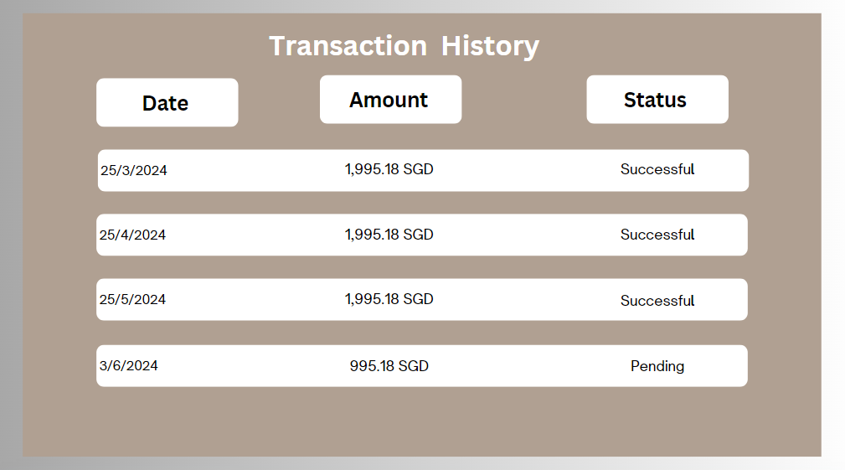

Slide 22
